Slide 1

Home Sweet & Smart Home Mian Si 991735464

Slide 2

Agenda
Project Overview
System Features
Architecture & Components
Implementation
Demo & Results
Challenges & Solutions
Future Work
Conclusion

Slide 3

Project Overview
Build a smart home system using ESP32.
Features include automatic climate control, security monitoring, and Telegram alerts.
Data is sent in real-time to Blynk cloud for visualization.

Slide 4
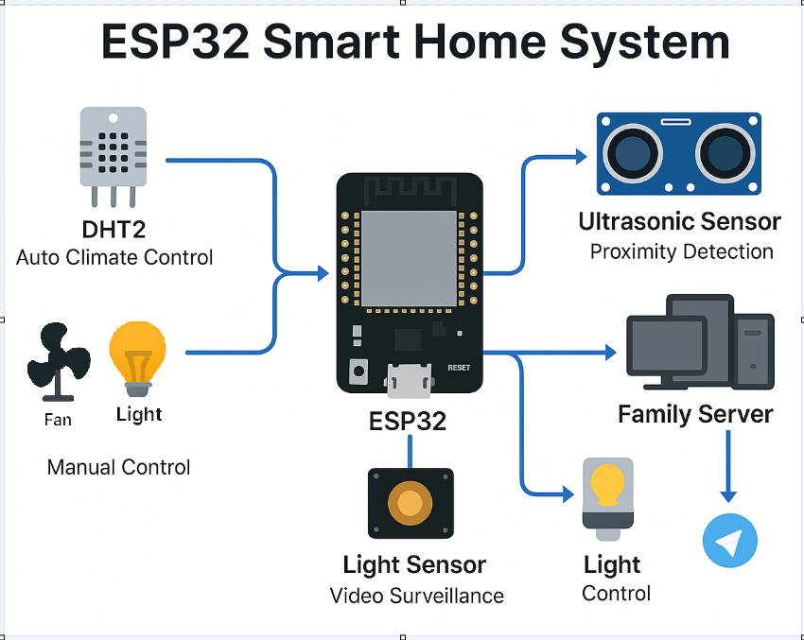
System Features
Automatic Temperature & Humidity Control
Automatic Light Control
Manual Override from remote
Proximity Detection at Front Door
Video Recording & Upload
Telegram Notifications
Blynk Real-time Cloud Display

Slide 5

Architecture & Components
Hardware, Software

Slide 6
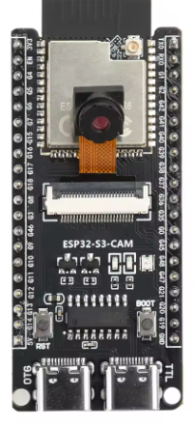
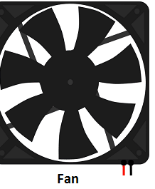
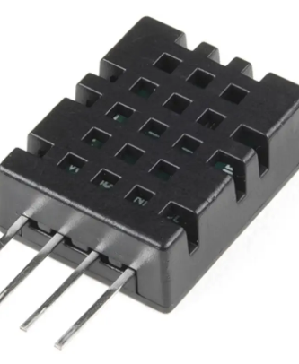
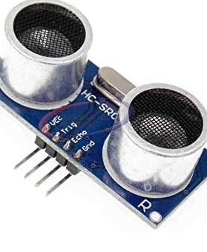
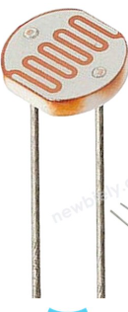
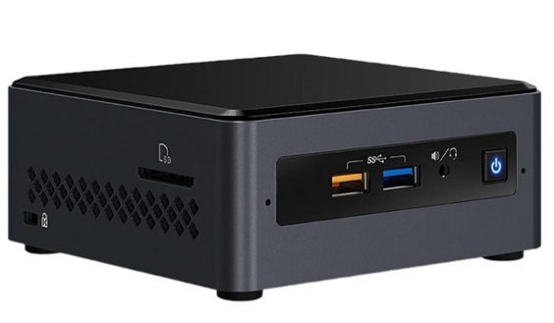
What we use to build this System
Hardware Components
ESP32-Wrover Microcontroller
DHT20 Sensor for Temperature & Humidity
Ultrasonic/IR Sensor for Door Monitoring
Fan and Humidifier
ESP32-CAM for Video Recording
PC-based Family Server for Video Processing & Upload

Slide 7







What we use to build this System
Software Components
Platform IO + VS Code
Arduino Framework
Blynk platform for Real-time Cloud Monitor
Telegram Bot API for notifications
Python for Family Server
Github.com

Slide 8
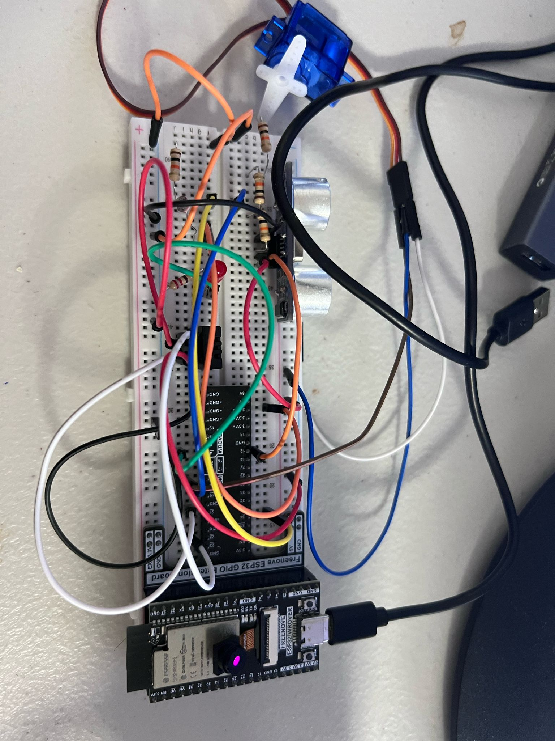
Implementations
Control, Data, and Logic

Slide 9
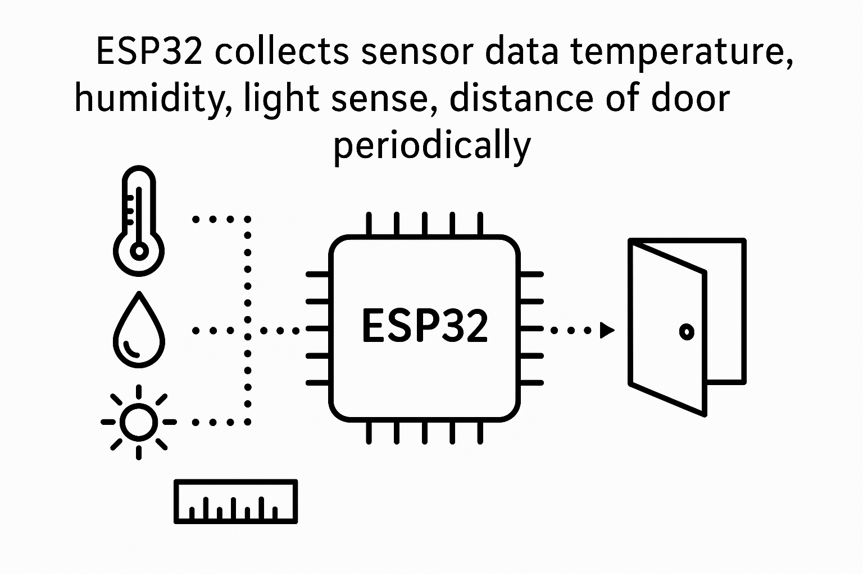
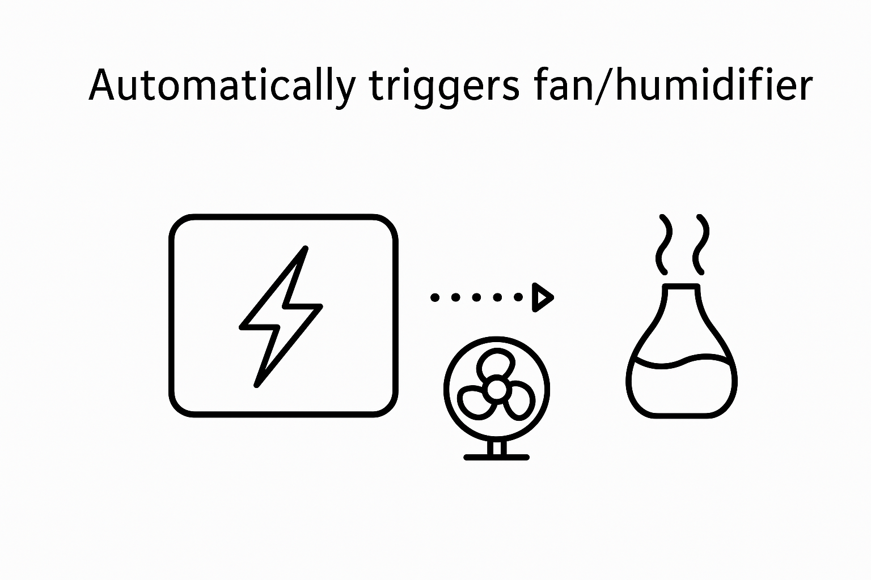
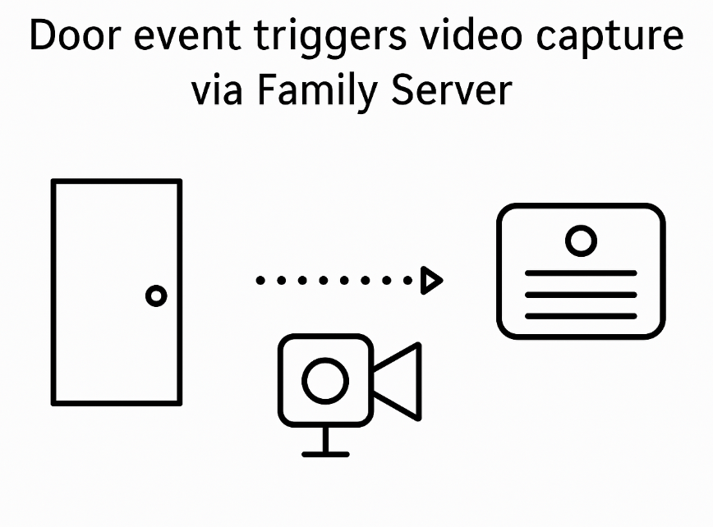
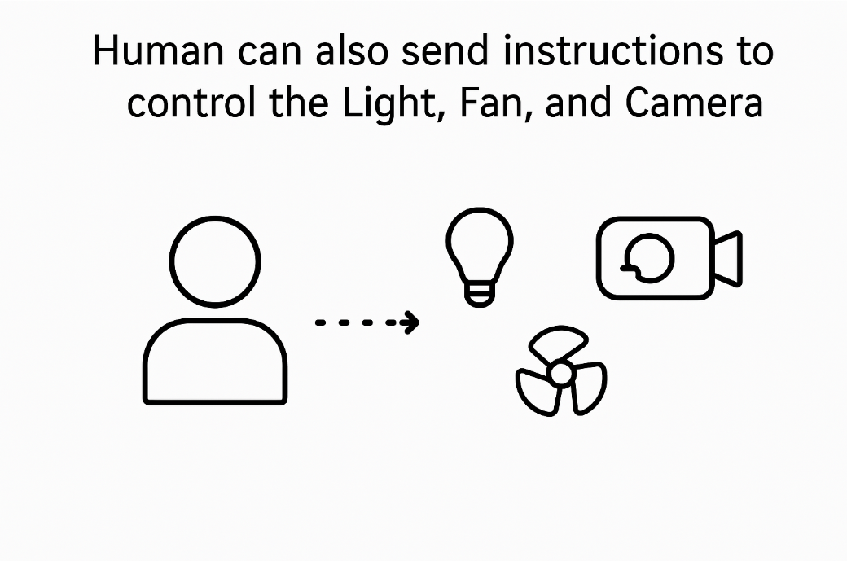
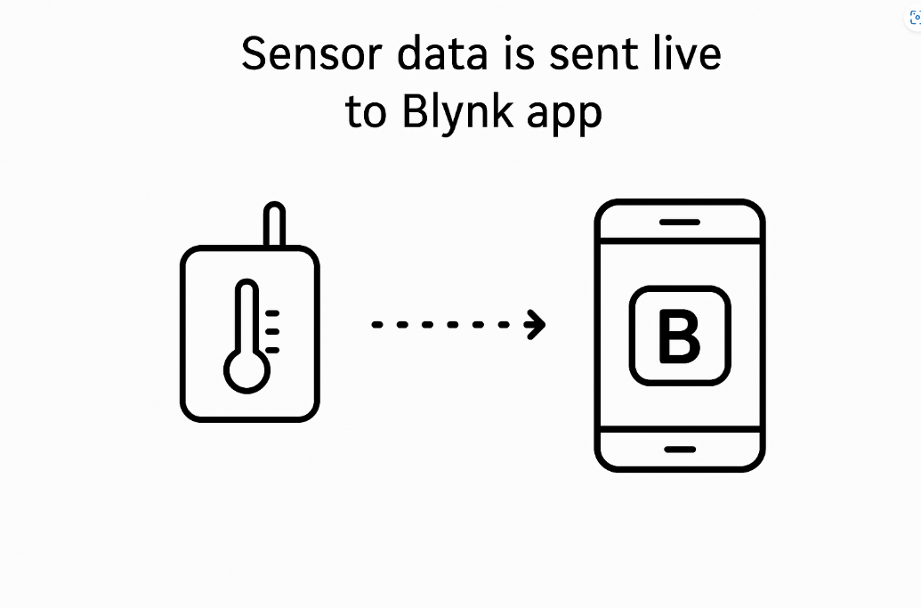
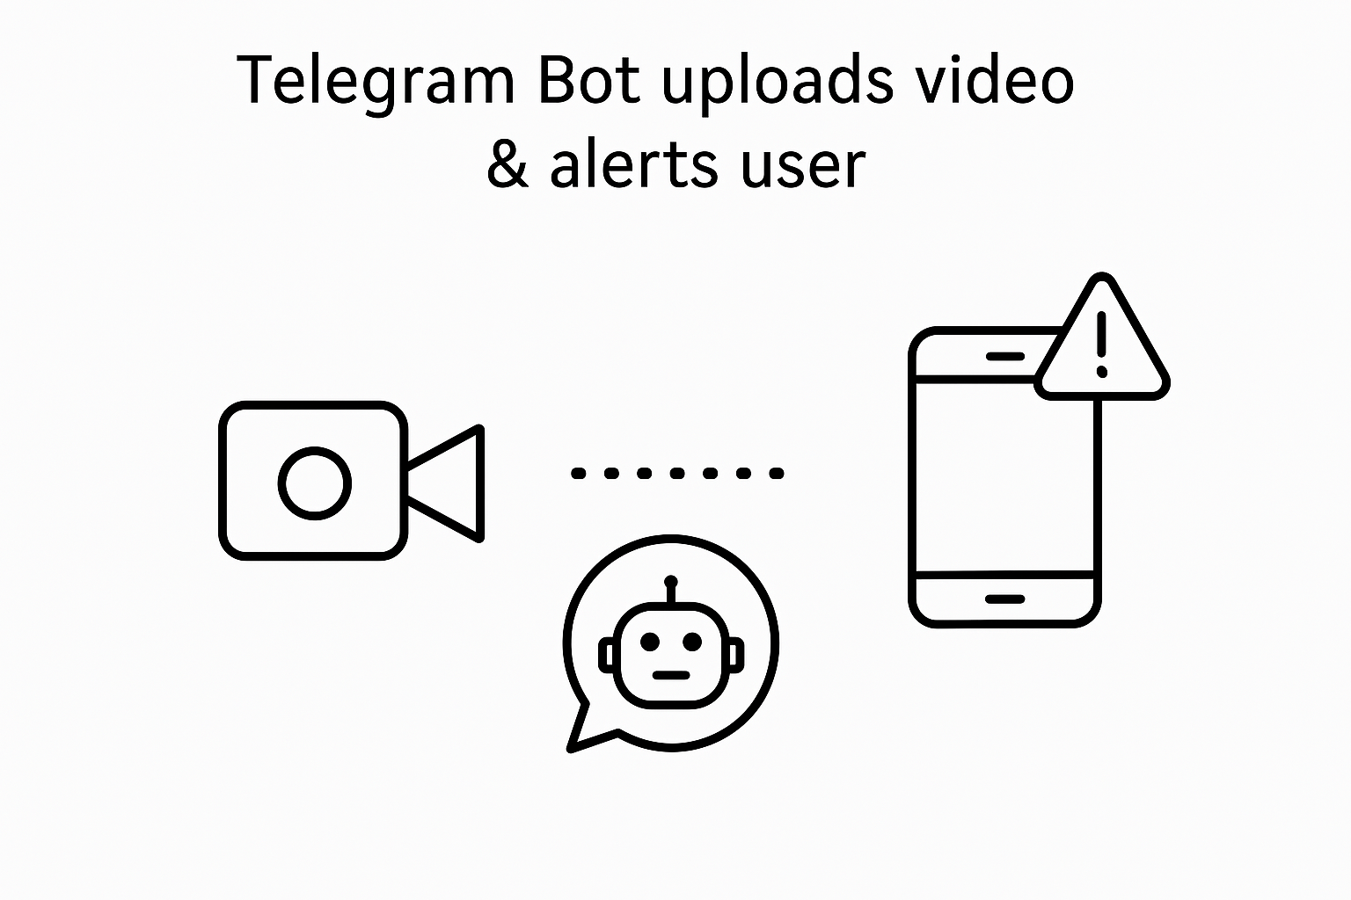
Implementations – Control flow

Slide 10
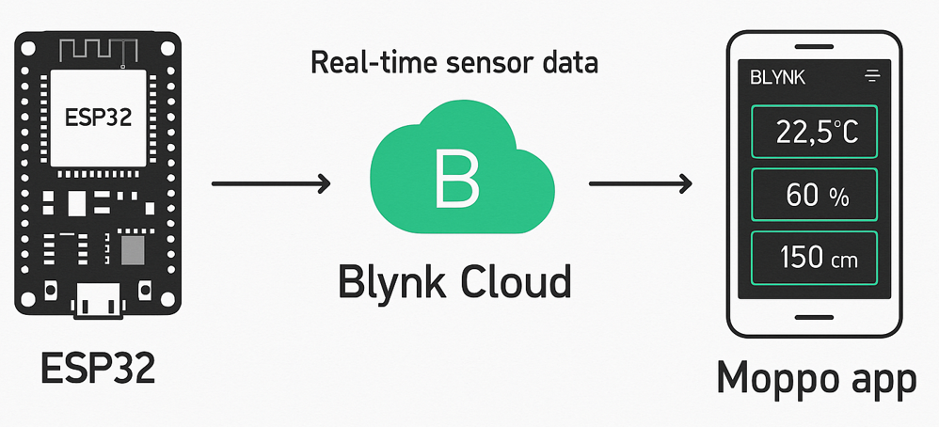
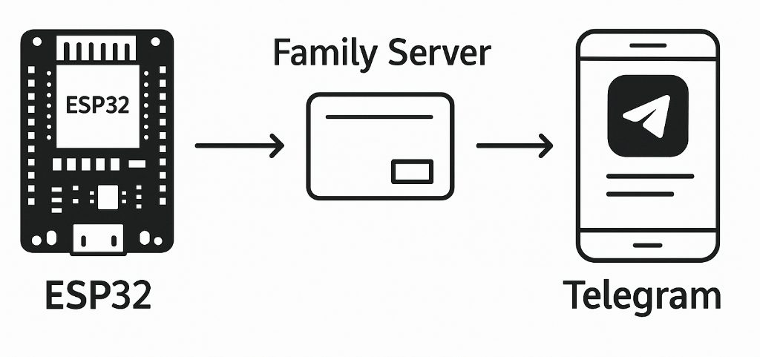
Implementations – Data flow

Slide 11
Implementations - Parameters
There are some critical data that we use to monitor the sensors and activate the actuators
Parameter | Measurement | Target | Changeable
Temperature threshold | ℃ | 26 | Yes
Humidity threshold | % | 80% | Yes
Light tense threshold | Lumen | 2500 | Yes
Distance from the door | cm | 50 | Yes
Video capture period | Second | 60 | Yes

Slide 12

Demo & Results
In our demo, we highlighted how effective communication leaves a lasting impact.
It's not just about delivering a message, but about connecting with the audience’s values, emotions, and experiences to truly resonate.

Slide 13
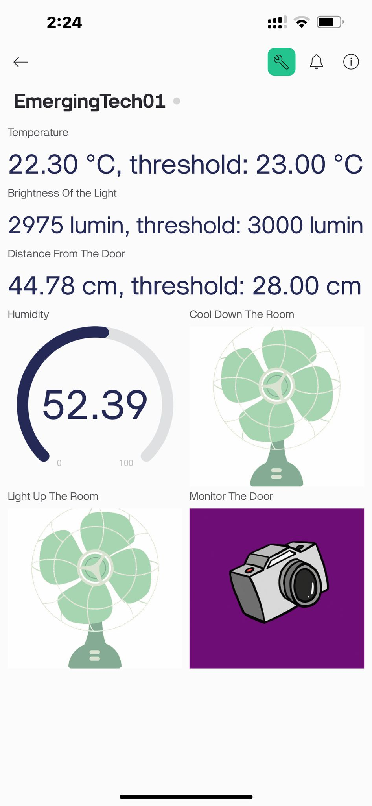
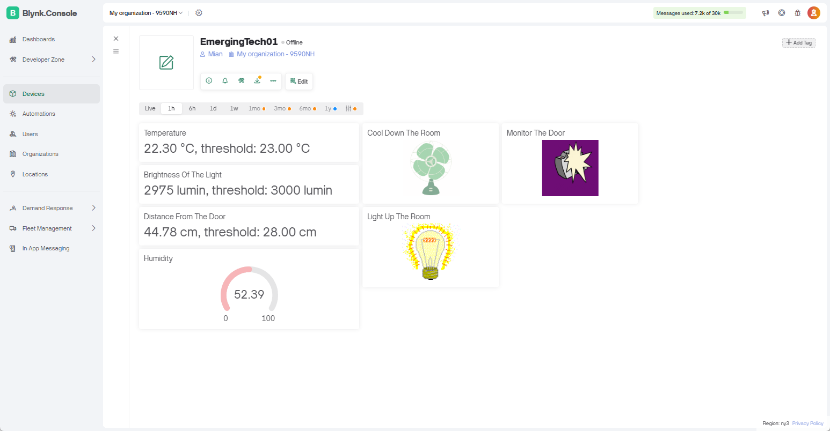
Demo & Results - Blynk

Slide 14
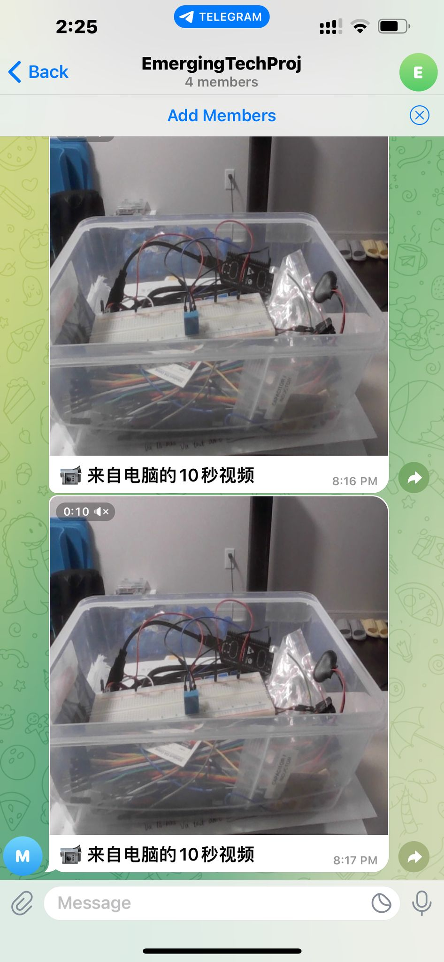
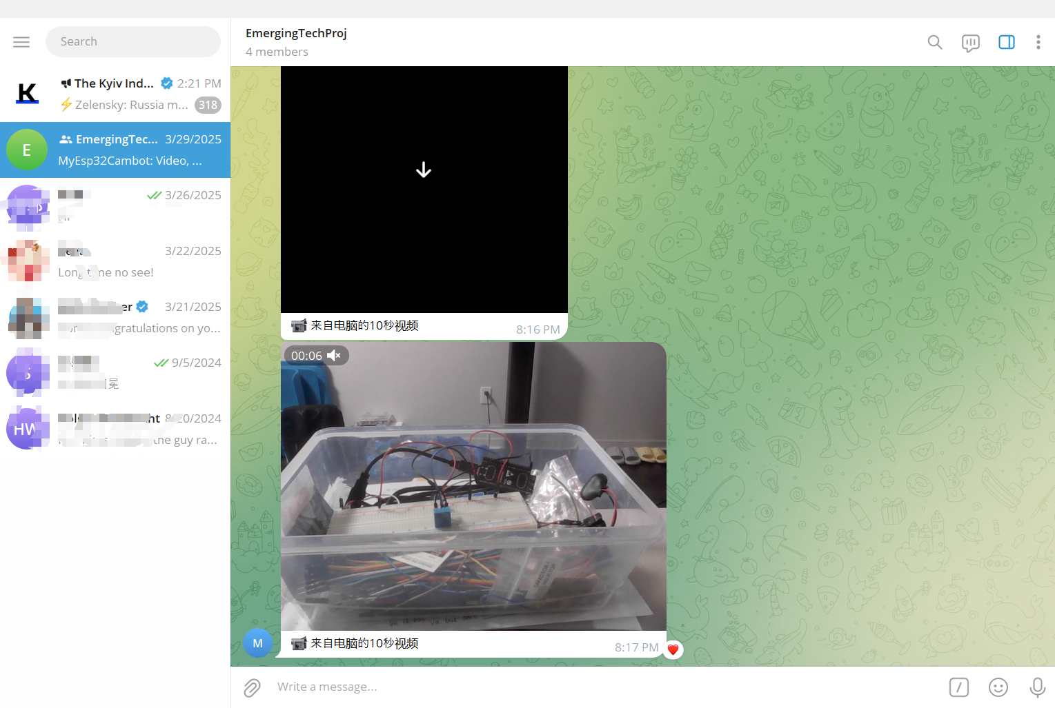
Demo & Results - Telegram

Slide 15
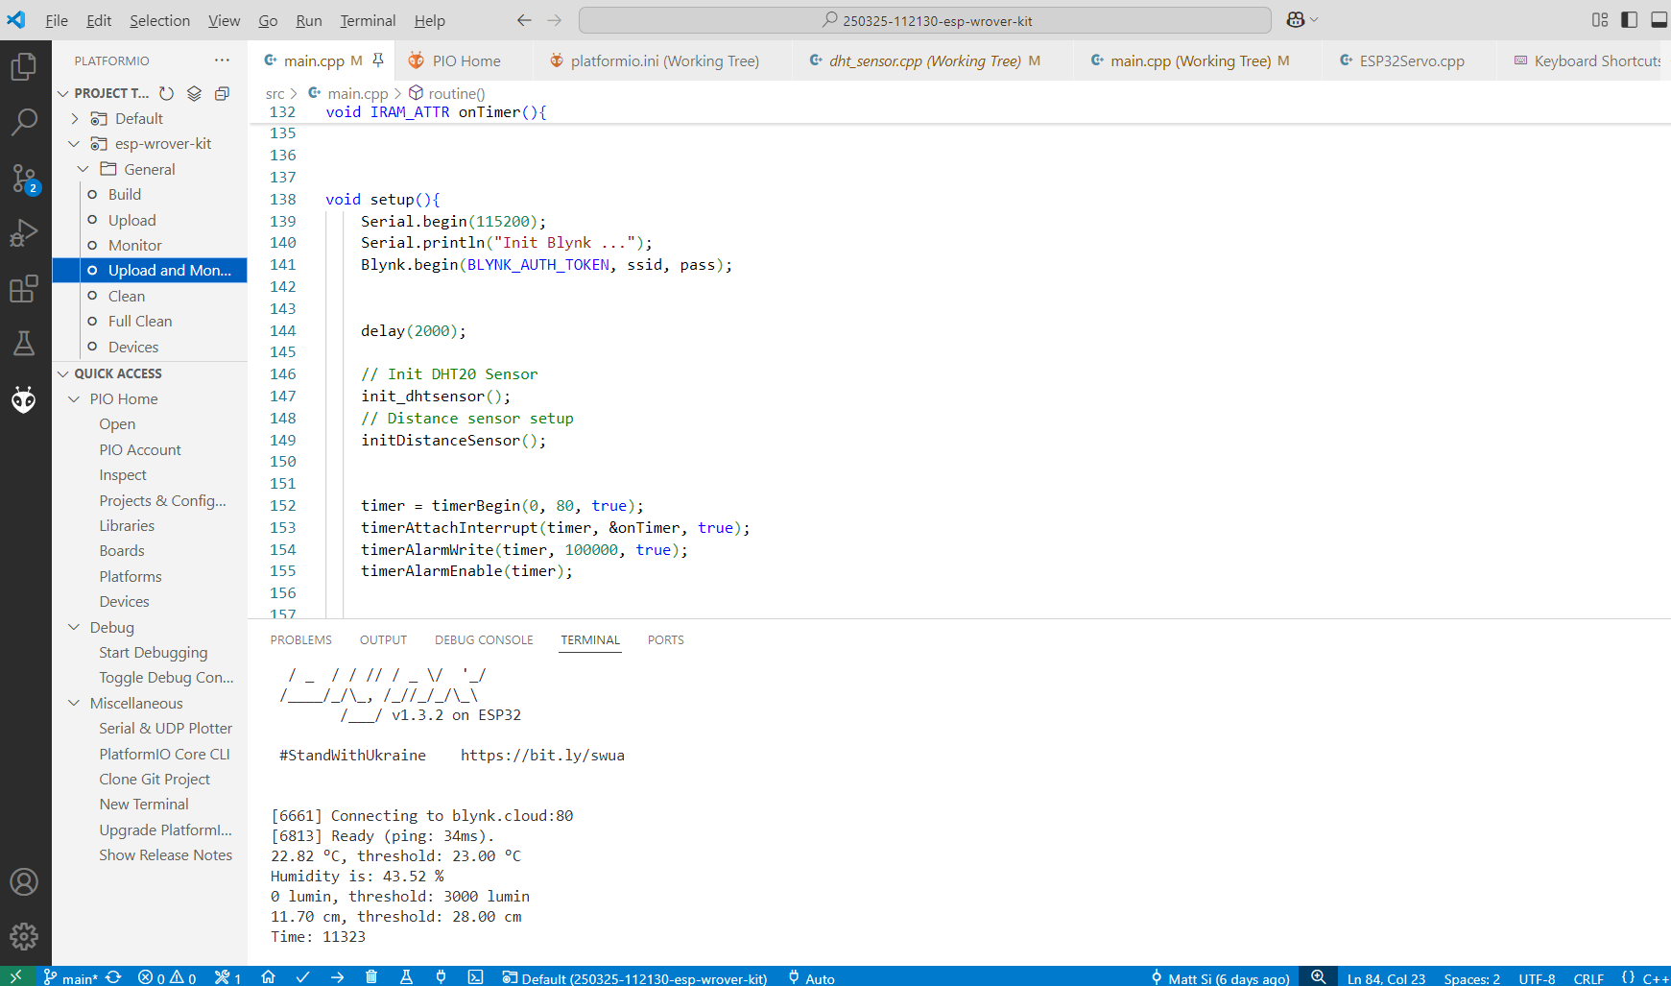
Demo & Results - Development

Slide 16
Challenges & Resolutions

Slide 17
Challenges & Resolutions
Arduino IDE is extremely slow when build ESP32 project.
Arduino always performs a full rebuild when compiling ESP32 project, which is very time-consuming.
Switch to Platform IO, which supports incremental builds.
Pins conflict; too many sensors are connected to one ESP32
Switch video capture functionality to laptop (Family Server)
Run out of free quota of Blynk
Register another account

Slide 18
Future Work
Hardware, Software and Protocols

Slide 19
Future Work
Hardware
Support for Multi-room System
Acquire more data with more sensors
Add more sensors
Smoke alert, noise alert, etc.
Software & Protocols
Strengthen family server
Receive and archive data from sensors
Analysis data by AI model for healthy suggestions
Replace HTTP protocols with MQTT
Make sure sensors communicate more efficiency

Slide 20
Conclusion Q&A
System combines automation, security, and remote control
Fully operational prototype with real-world usability
Modular design allows future scalability

